Slide 1
CODELCO UPDATE
July 2011

Slide 2

Highlights
Industry Overview
Operating Performance and Capex Program
Financial Review
Notes:
2

Slide 3

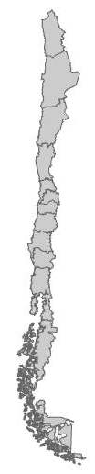
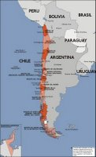
Competitive Strengths
CODELCO: The World’s Leading Mining Company with High Quality Assets
El Abra
CODELCO´s Leadership:
#1 Copper Producer
#2 Moly Producer
Chuqui
RT
MMH
CODELCO is one of the world’s lowest cost producers of copper: US¢ 98.2 cash cost**
Calama
Antofagasta
Gaby
C
H
I
L
E
CODELCO Resources: Largest world’s proven and probable copper reserves, 10%
Strong 1Q Financial Performance**:
EBITDA : US$2,750 mn
EBIDA Margin: 64%
Interest Coverage: 30x
Andina
Santiago
El Teniente
Ratings:
Moody’s A1 Stable
S&P A Stable
Fitch A+ Stable
DBRS A Stable
Largest company in Chile: Contributes 16% of Chilean government budget *
* Average contribution to Chilean Government Budget from 2006 to 2010
** As of 1Q 2011

Slide 4
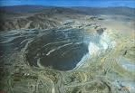
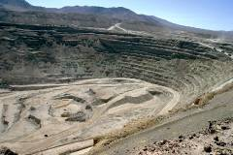
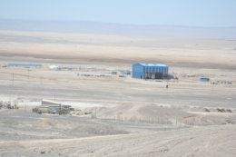



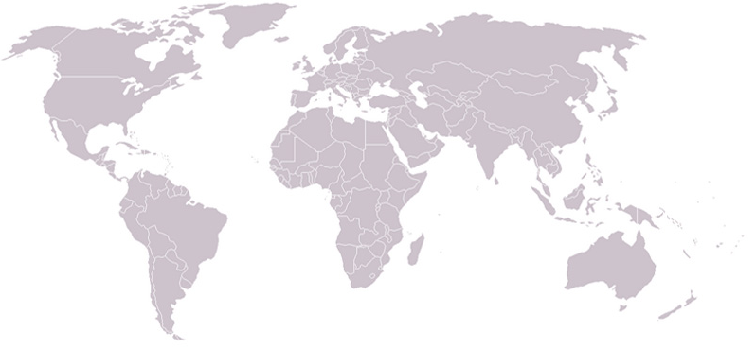
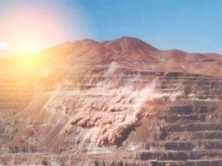

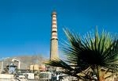


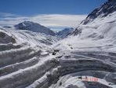
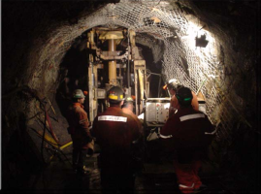

Codelco: Operations and Global Commercial Presence*
Radomiro Tomic
Division
Copper
Ministro Hales
Division
Copper
New York - US
Codelco Group Inc.
London - UK
Chile Copper
Ltd.
Chuquicamata Division
Copper
Düsseldorf - Germany
Codelco Kupferhandel GMHB
El Abra
Copper
Gabriela Mistral
Operation
Copper
Ventanas
Smelter & Refinery
Division
Salvador
Division
Copper
Shanghai - China
Representative Office
Andina
Division
Copper
El Teniente
Division
Copper
*: Commercial Subsidiaries.
Santiago
Headquarters
Notes:
4

Slide 5
World Leader in the Copper and Molybdenum Industry
Leadership in Copper Production
Leadership in Copper Reserves
Second Largest Molybdenum Producer
Long Life Copper Resources
 | TOTAL MINERAL RESOURCES* (mn of tonnes)
 | Mineral | Ore Grade (%) | Copper
Chuquicamata | 3,277 | 0.57 | 18.7
Radomiro Tomic | 2,584 | 0.47 | 12.3
MMH | 902 | 0.91 | 8.2
Salvador | 341 | 0.53 | 1.8
Andina | 5,888 | 0.78 | 45.8
El Teniente | 4,176 | 0.84 | 35.1
Minera Gaby S.A. | 553 | 0.39 | 2.2
CODELCO | 17,721 | 0.70 | 124.1
*: Proven and Probable Reserves and Identified Mineral Resources in Minning Plan of BDP
Source: Codelco
Notes:
5

Slide 6
Fully Integrated and Stable Operations & Diversified Sales
1Q 2011 Sales Breakdown by Product
1Q 2011 Sales Breakdown by Region
 | US$ millions | Share
Copper | 3,874 | 90.0%
Molybdenum | 177 | 4.1%
Other Products (wire rod, sulfuric acid, etc..) | 254 | 5.9%
Total | 4,305 | 100%
Oceania 1%
South America 9%
North America 12%
China 35%
Europe 23%
Asia (ex. China) 21%
1Q 2011 Copper Sales Breakdown (mft)
1Q 2011 Top Clients
Concentrate 11%
Nexans Copper France | France
Southwire Company | USA
Codelco Kupferhandel | Germany
Copper Partners | China
Cobre Cerrillos S.A. | Chile
Maike Metals Int. Ltd | China
LS Cable Company Ltd | South Korea
Ningbo Sunhu Chem. Products | China
Wanxiang Resources Co. | China
- Cathodes 79%
- Fire refined 6%
- Blister 4%
Source: Codelco
Notes:
6

Slide 7
Highlights
Industry Overview
Operating Performance
Financial Review
Notes:
7

Slide 8
Copper Real Price
2008-2009
Subprime Crisis
2004-2008
Price “Boom” principally
provoked by China irruption
1997-2003
Excessive stock levels,
increase in Chilean
Production, Asian Crisis
1930
Great Depression
Source: WBMS, IMF and Codelco. *: USA: 1980 – 2004. 2010: Forecast.
Notes:
8

Slide 9

Copper Prices & Stocks in Metal Exchanges
’000t
c/lb
Metal Exchanges: London, COMEX and Shangai
Notes:
9

Slide 10
Consensus about Solid Market Fundamentals
World Refined Copper Consumption
GDP and Copper Consumption per Capita**
‘000 tonnes
2010*
Taiwan
Developing Countries: 39%
China: 38%
South Korea
China
Others: 15%
India: 3%
Kg of Copper / Person
Germany
Brazil 2%
Russia: 2%
Japan
USA
Other Developing Countries
China
Russia
India
Brazil
GDP per Capita (PPP)
India
Developed Countries
Source: WBMS, FMI, World Bank
*Figures 2010: Forecast. ** Period 1980 – 2010
Notes:
10
10
10

Slide 11

Consensus about Solid Market Fundamentals
Urbanization Rate (%)
China’s Urbanization: Transformation towards 2025
220 million will be added to China’s urban population: More than Brazil population
105 airports (US has 86), 60,000 km of expressways (more than 4 times Australia’s Highway 1, the longest national highway in the world), and 45,000 km of railways are expected to be built by 2020 (3 times UK railways)
60% of China’s citizens will be living in cities
  5 million buildings will be built ➔ 50,000 could be Skyscrapers: Equivalent to 10 NYC
  170 Mass-Transit Systems could be built: Only 70 in Europe
Source: UN Department of Economic and Social Affairs: “World Urbanization Prospects: the 2009 revision; McKinsey Global Institute, March 2009; NDRC; CAAC; Ministry of Transport of China

Slide 12

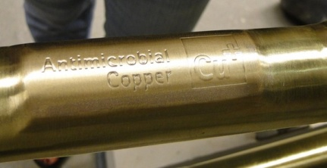
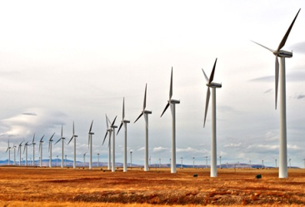


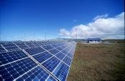
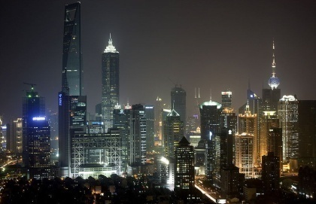
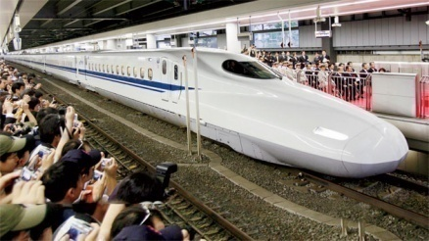


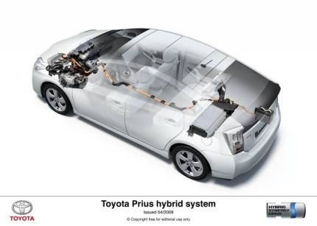
New Trends Provide Opportunities for Copper
New Technological Applications
Anti-Bacterial
Properties
Renewable Energies
Aquaculture
World Electrification
Electrical Propulsion
Hybrid & Electric Cars
Green & Smart Building
High Efficiency Motors
Source: ICA and Codelco.
Notes:
12
12
12

Slide 13
World Mine Production: Major trends
Industry’s Average Grade
Lower number of large deposits will be developed in the future. Some factors that influence this trend:
  Lower probability of discovering high grade / large size deposits. Ore grade will continue to decline.
  Many new mines will be U/G operations (U/G mines tend to have lower rates of production than open pits).
  Country risk (New mines tend to be in countries with high sovereign risk).
  Infrastructure (located in remote areas).
  Financing (capital costs escalation and tighter credit market).
Source: Codelco and Brook Hunt

Slide 14
Consensus about Future Copper Deficit
‘000 tonnes
Production, Consumption
Balance
20.000
1.000
Production
18.000
Consumption
600
16.000
200
14.000
2004
2005
2006
2007
2008
2009
2010
2011 (f)
2012 (f)
-
200
Balance
12.000
-
600
Production, Consumption
Balance
10.000
-
1.000
Sources: CDEL: Codelco, December 2010 ;BME: Bloomsbury, April 2011; BH: Brook Hunt, April 2011; CRU, April 2011

Slide 15
Positive Outlook for Copper Price
Price (c/lb, currency 2011)
 | 2011 | 2012 | 2013 | 2014 | 2015
Bloomsbury | 444 | 432
Brook Hunt | 460 | 451 | 388 | 293 | 234
CRU | 456 | 445 | 406 | 389 | 398
Analysts' Average | 454 | 442 | 397 | 389 | 398
Barclays | 486 | 544
Citigroup | 453 | 427 | 383 | 305 | 253
Deutsche Bank | 475 | 522 | 443 | 346
Goldman Sachs | 474 | 494 | 415 | 357 | 325
Macquarie | 481 | 525 | 341 | 286 | 325
Merrill Lynch | 478 | 510 | 420 | 367
Banks' Average | 475 | 504 | 400 | 332 | 301
Analysts and Banks Average | 467 | 483 | 399 | 335 | 307
Cochilco | 430 | 404
Note of Publication Dates: Barclays, Jun-11; Citigroup, Jun-11; Deutsche Bank, Jun-11; Goldman Sachs, May-11; Merril Lynch, Jun11; Bloomsbury, May-11; Brook Hunt, Jun-10; CRU, Apr-11; Macquarie, May-2011; Cochilco, Jan-11

Slide 16
Highlights
Industry Overview
Operating Performance and Capex Program
Financial Review
Notes:
16

Slide 17
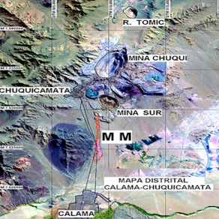
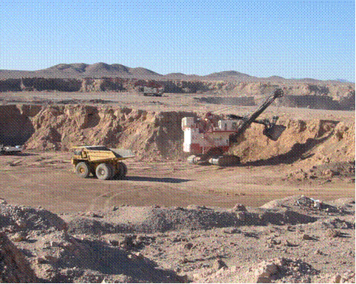
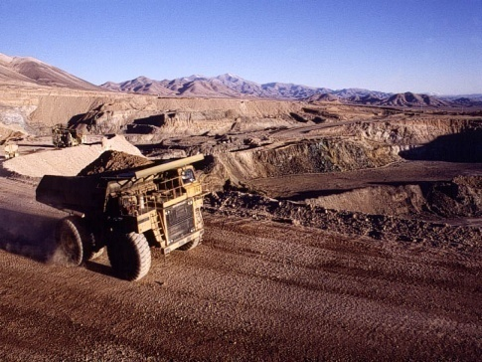
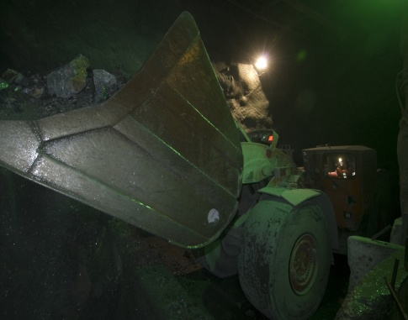
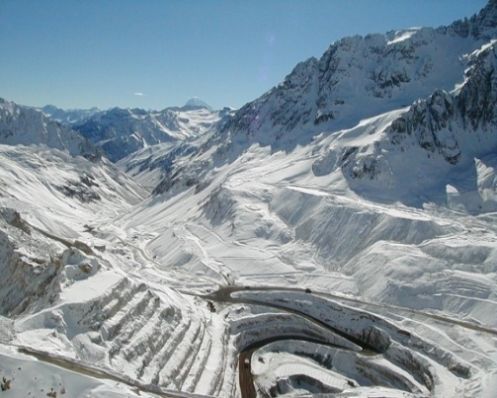
Chuquicamata
Radomiro Tomic
Ministro Hales
High quality assets: Mine Operations
2010 figures
2010 figures
2010 figures
Production
(thousand tons)
Production
(thousand tons)
Starting Operation in
2013
Copper
528
Copper
375
Antofagasta
Calama
Molybdenum
11
Molybdenum
1
Resources
(mill mft)
13
Cash Cost
(c/lb)
106.6
Cash Cost
(c/lb)
96.7
C
H
I
L
E
Resources
(mill mft)
60
Resources
(mill mft)
27
Gabriela Mistral
Salvador
2010 figures
Santiago
2010 figures
Production
(thousand tons)
Production
(thousand tons)
Copper
117
Copper
76
Molybdenum
1
Cash Cost
(c/lb)
129.9
Cash Cost
(c/lb)
182.3
Resources
(mill mft)
4
Resources
(mill mft)
14
El Teniente
Andina
2010 figures
2010 figures
Production
(thousand tons)
Production
(thousand tons)
Copper
188
Copper
404
Molybdenum
3
Molybdenum
6
Cash Cost
(c/lb)
124.8
Cash Cost
(c/lb)
109.3
Resources
(mill mft)
114
Resources
(mill mft)
105
Notes:
17

Slide 18
Codelco: 5 year Results
1Q Production
1Q Profit before taxes and copper price
’000 tonnes
US$ Million c/lb
Miles de tmf
1Q Direct Cash Cost (C1)
1Q Frequency rate of Accidents*
c/lb
** Includes own workers and contractors. Accidents with Lost Time / Million Working Hours

Slide 19
Codelco: An Unprecedented Investment Challenge
US$ million, 2011 currency
Codelco’s Main Short Term and Structural Mining Projects
2013
MMH
170,000 tonnes/year
2017
El Teniente
New Mine Level
430,000 tonnes/year
2018
Andina Phase II
350,000 tonnes/year
2018
Chuqui
Underground
315,000 tonnes/year
Under Construction
In Feasibility Study
Past and Future Capex Program Overview
* Preliminary investment figures

Slide 20
Major Projects & Projection of Copper Production
‘000 tonnes
Projection Sources: Year 2011: Budget. Years 2012-2013: Triennial Plan proposed to the Finance and Mining Ministries. Years 2014-2020: Business and Development Plan (PND) 2011. It does not include the share of Codelco in El Abra.
Notes:
20

Slide 21
Evolution and Projection of Codelco’s Production:
The Priority of Structural Projects
‘000 Tonnes
Note: Codelco includes the 49% share in El Abra.
Source of Projections: Year 2011: Budget. 2012: Triennial Plan proposed to the Finance and Mining Ministries. 2020: Business and Development Plan (PND) 2011 and Plan without Development (PSD) 2011, and El Abra.

Slide 22
Highlights
Industry Overview
Operating Performance
Financial Review
Notes:
22

Slide 23
Strong Track Record
(US$ million)
 | 2008 | 2009 | 2010 | Change
Copper Production (thou. mft)⁽¹⁾ | 1,548 | 1,782 | 1,760 | (0.7)%
Cash Cost (US¢/pound)⁽²⁾ | 70.2 | 92.9 | 104.4 | 12.4%
LME Copper price (US¢/pound) | 315.3 | 234.2 | 342.0 | 46.0%
Total Sales | $14,425 | $12,379 | $16,066 | 29.8%
Gross Profit | $5,584 | $4,895 | $6,977 | 42.5%
Gross Margin | 38.7% | 39.5% | 43.4% | 9.9%
EBITDA⁽³⁾ | $6,233 | $5,348 | $7,435 | 39.0%
EBITDA Margin | 43.2% | 43.2% | 46.3% | 7.2%
Net Interest Expense⁽⁴⁾ | $181 | $291 | $296 | 1.7%
Capex | $1,962 | $2,127 | $2,616 | 23.0%
EBITDA / Net Interest Expense | 34.4x | 18.4x | 25.1x | 36.4%
Includes Codelco’s share of El Abra’s production.
Cash cost is always relative to a metal and expressed per unit of production. It includes all cash expenses of production net of the revenues from other metals extracted that are not copper.
Calculated as operating income plus depreciation and amortization.
Includes provisions and other financial expenses
Note: In 2010 the Corporation changed its accounting method to IFRS
Notes:
23

Slide 24
Strong Track Record
(US$ million)
 | 1Q 2010 | 1Q 2011 | Change
Copper Production (thou. mft)⁽¹⁾ | 402 | 425 | 5.7%
Cash Cost (US¢/pound)⁽²⁾ | 102.3 | 98.2 | (4.0)%
LME Copper price (US¢/pound) | 328.6 | 437.5 | 33.1%
Total Sales | $3,314 | $4,305 | 29.9%
Gross Profit | $1,416 | $1,962 | 38.6%
Gross Margin | 42.7% | 45.6% | 6.8%
EBITDA⁽³⁾ | $1,609 | $2,750 | 70.9%
EBITDA Margin | 48.6% | 63.9% | 31.5%
Net Interest Expense⁽⁴⁾ | $74 | $66 | (10.8)%
Capex | $529 | $475 | (10.2)%
EBITDA/Net Interest Expense⁽⁵⁾ | 20.2x | 29.8x | 47.5%
Includes Codelco’s share of El Abra’s production
Cash cost is always relative to a metal and expressed per unit of production. It includes all cash expenses of production net of the revenues from other metals extracted that are not copper
Calculated as Net Profit plus Taxes, Finance Costs, and Depreciations and Amortizations
Includes provisions and other financial expenses
Calculated as last 12 month
Note: In 2010 the Corporation changed its accounting method to IFRS
Notes:
24

Slide 25
Conservative Debt Maturity Profile (March, 2011)
Debt Maturities Schedule – US$ million

Slide 26
This presentation has been prepared by Corporación Nacional del Cobre de Chile (“Codelco” or the “Company”) in connection with the proposed
offering of the securities described herein. This presentation does not constitute or form part of an offer or any solicitation to any other person or to the
general public to subscribe for or otherwise acquire securities issued by Codelco in any jurisdiction or an inducement to enter into investment activity,
nor shall it (or any part of it) or the fact of its distribution or availability, form the basis of, or be relied on in connection with, or act as any inducement
to enter into, any contract or commitment or investment decision whatsoever with respect to the proposed offering or otherwise.
The information contained in this independently presentation has not been verified and is subject to change without notice. No representation or
warranty express or implied is made as to and no reliance should be placed on, the fairness, accuracy, completeness or correctness of the
information or the opinions contained herein. None of the Company,any of its respective affiliates, advisers or representatives shall have any liability
whatsoever (in negligence or otherwise) for any loss howsoever arising from any use of this presentation or its contents or otherwise arising in
connection with the presentation.
This presentation is only for persons having professional experience in matters relating to investments and must not be acted or relied on by persons
who are not relevant persons.
This presentation includes ‘forward-looking statements’. These statements may include words such as “anticipate”, “believe”, “intend”, “estimate”,
“expect” and words of similar meaning. All statements other than statements of historical facts included in this presentation, including, without
limitation, those regarding the Company’s financial position, business strategy, plans and objectives of management for future operations (including
development plans and objectives relating to the Company’s products and services) are forward-looking statements. Such forward-looking
statements involve known and unknown risks, uncertainties and other important factors that could cause the actual results, performance or
achievements of the Company to be materially different from future results, performance or achievements expressed or implied by such forwardlooking
statements. Such forward-looking statements are based on numerous assumptions regarding the Company’s present and future business
strategies and the environment in which the Company will operate in the future. These forward-looking statements speak only as at the date of this
presentation. The Company expressly disclaims any obligation or undertaking to disseminate any updates or revisions to any forward-looking
statements contained herein to reflect any change in the Company’s expectations with regard thereto or any change in events, conditions or
circumstances on which any such statement is based.
As is standard in the industry, CODELCO divides its mineral holdings into two categories, reserves and resources. Resources are ore bodies of
economic value that have been identified and evaluated through exploration, reconnaissance and sampling. Reserves are the portion of the resource
that can be extracted based on an economic, environmental and technological analysis set forth in the mining plan. Reserves and resources are both
subdivided further, based on the degree of knowledge that CODELCO has of their extent and composition. The system used by CODELCO for
categorizing mineral ore is widely used within the mining industry (and codified in such international regulations as the Joint One Reserves
Committee (JORC) code of Australia, the South African Mineral Resources Committee (SAMREC), and the Reporting Code of Great Britain). Other
systems of categorization are also used; one such system is that used by the U.S. Geological Survey.
This presentation may not be taken away with you. The contents of this presentation may not be reproduced, redistributed or passed on, directly or
34
Copyrights © 2010 by CODELCO-CHILE. All Rights Reserved.
indirectly, to any other person or published, in whole or in part, for any purpose.
Disclaimer
This presentation has been prepared by Corporación Nacional del Cobre de Chile (“Codelco” or the “Company”) This presentation does not constitute or form part of an offer or any solicitation to any other person or to the general public to subscribe for or otherwise acquire securities issued by Codelco in any jurisdiction or an inducement to enter into investment activity, nor shall it (or any part of it) or the fact of its distribution or availability, form the basis of, or be relied on in connection with, or act as any inducement to enter into, any contract or commitment or investment decision.
The information contained in this independently presentation has not been verified and is subject to change without notice. No representation or warranty express or implied is made as to and no reliance should be placed on, the fairness, accuracy, completeness or correctness of the information or the opinions contained herein. None of the Company, any of its respective affiliates, advisers or representatives shall have any liability whatsoever (in negligence or otherwise) for any loss howsoever arising from any use of this presentation or its contents or otherwise arising in connection with the presentation.
This presentation is only for persons having professional experience in matters relating to investments and must not be acted or relied on by people who are not relevant persons.
This presentation includes ‘forward-looking statements’. These statements may include words such as “anticipated”, “believe”, “intend”, “estimate”, “expect”, “preliminary” and words of similar meaning. All statements other than statements of historical facts included in this presentation, including, without limitation, those regarding the Company’s financial position, business strategy, plans and objectives of management for future operations (including development plans and objectives relating to the Company’s products and services) are forward-looking statements. Such forward-looking statements involve known and unknown risks, uncertainties and other important factors that could cause the actual results, performance or achievements of the Company to be materially different from future results, performance or achievements expressed or implied by such forward looking statements. Such forward-looking statements are based on numerous assumptions regarding the Company’s present and future business strategies and the environment in which the Company will operate in the future. These forward-looking statements speak only as at the date of this presentation. The Company expressly disclaims any obligation or undertaking to disseminate any updates or revisions to any forward-looking statements contained herein to reflect any change in the Company’s expectations with regard thereto or any change in events, conditions or circumstances on which any such statement is based.
As is standard in the industry, CODELCO divides its mineral holdings into two categories, reserves and resources. Resources are ore bodies of economic value that have been identified and evaluated through exploration, reconnaissance and sampling. Reserves are the portion of the resource that can be extracted based on an economic, environmental and technological analysis set forth in the mining plan. Reserves and resources are both subdivided further, based on the degree of knowledge that CODELCO has of their extent and composition. The system used by CODELCO for categorizing mineral ore is widely used within the mining industry (and codified in such international regulations as the Joint One Reserves Committee (JORC) code of Australia, the South African Mineral Resources Committee (SAMREC), and the Reporting Code of Great Britain). Other systems of categorization are also used; one such system is that used by the U.S. Geological Survey. This presentation may not be taken away with you. The contents of this presentation may not be reproduced, redistributed or passed on, directly or indirectly, to any other person or published, in whole or in part, for any purpose.

Slide 27
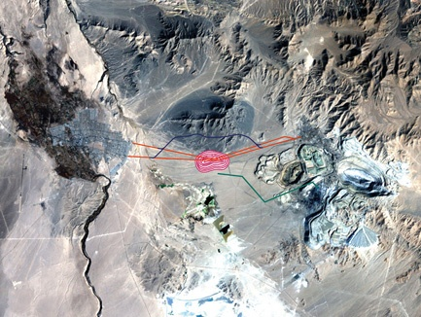
Codelco’s Project Portfolio:
Ministro Hales
Description | New Copper deposit next to Chuquicamata (Calama) Open pit mine, concentrator and toaster
Capacity | 170,000 ton/year
Starting Production | 2013
Status | MH Division has been created Approval Investment Pre-stripping has started and plant construction will start in 2nd semester 2011

Slide 28
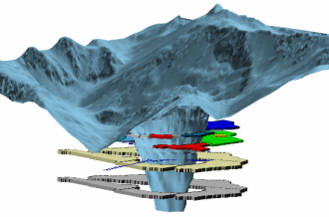
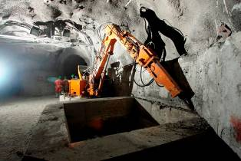
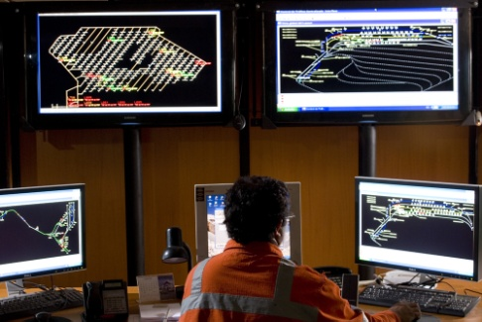
Codelco’s Project Portfolio:
El Teniente New Mine Level
Description | New mine level development in El Teniente Increase in extraction rate from 124,000 to 137,000 tpd
Capacity | 430,000 ton/year
Starting Production | 2017
Status | Feasibility study ended (March 2011) Early works under construction (Platform, Ramp)

Slide 29
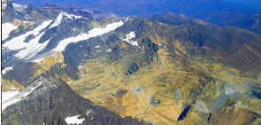
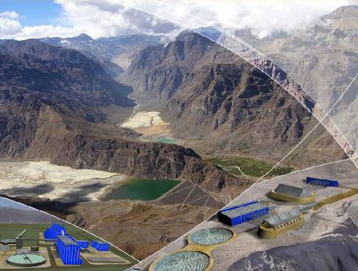
Codelco’s Project Portfolio:
Andina Phase II
Description | Increase capacity from 94,000 to 244,000 tpd Open Pit and Undergound Mine operations
Capacity | 350,000 ton/year (additional to actual production)
Starting Production | 2018
Status | Feasibility Study (finished July 2012).

Slide 30
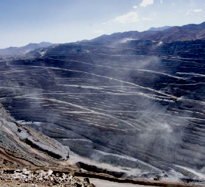
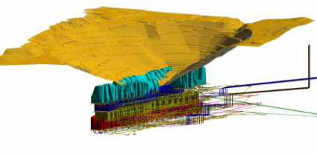
Codelco’s Project Portfolio:
Chuquicamata Underground
Description | Underground mine development in the world’s biggest open pit mine Copper and Molybdenum production
Capacity | 315,000 ton/year
Starting Production | 2018
Status | Feasibility Study (finished 2013) Early construction works (4Q 2011)

